Slide 1
Vlaams Supercomputer Centrum
Current Trends in Long Read Sequencing and Bioinformatics Analysis
October, 3rd, 2024
vscentrum.be

Slide 2

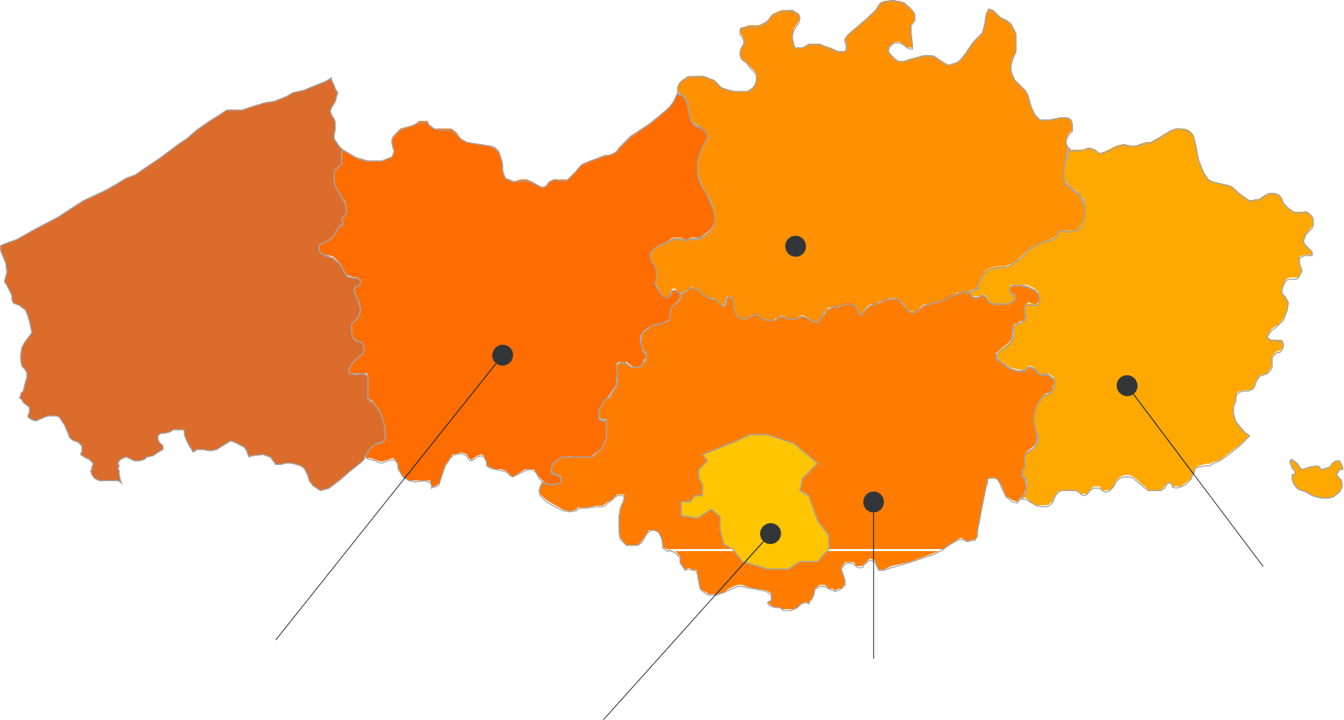


















VSC PARTNERSHIP
A n t w e r p e n
O o s t
V l a a n d e r e n
Supported by
W e s t
V l a a n d e r e n
L i m b u r g
V l a a m s - B r a b a n t
B r u s s e l
vscentrum.be
2
Notes:
VSC is a partnership between 5 major universities and associations in Flanders, namely … and is spread among 4 sites. VSC is sponsored by the flemish research organization FWO. The idea is that the academics (scientists, students) and industrial partners in Flanders have an easy access to compute and storage facilities. Hence any individual with a single VSC account is eligible to compute on any cluster/site that he/she deires

Slide 3
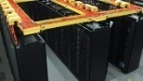

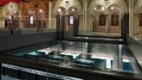



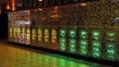
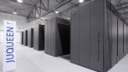
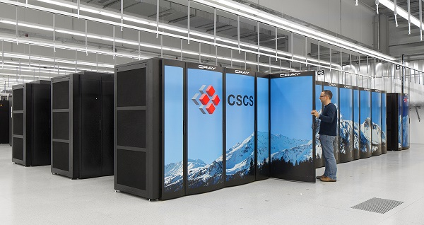
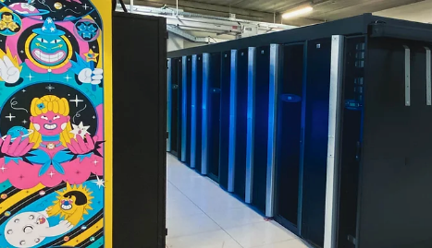
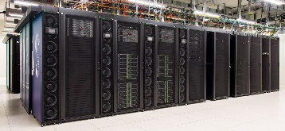





VSC HPC Environments
Policy rules
Tier-0
Compute
Cloud
Data
Tier-1
Hortense
Tier-2
STEVIN | HYDRA | VAUGHAN/LEIBNIZ | GENIUS/WICE
3
Notes:
All VSC users can use Tier-2 clusters from any site they desire.
If you still require more compute resources which does not fit into available Tier-2 limits, you can apply for Tier-1 compute time.
Even if Tier-1 level is insufficient, you can apply for Tier-0 level where Belgium is also part of a European consortium.

Slide 4
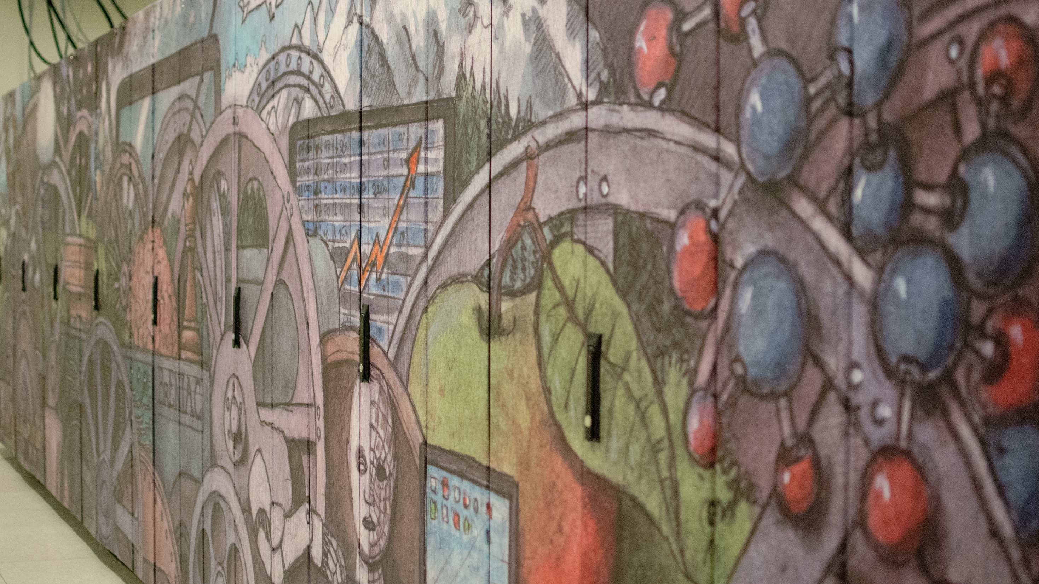
Compute

Slide 5
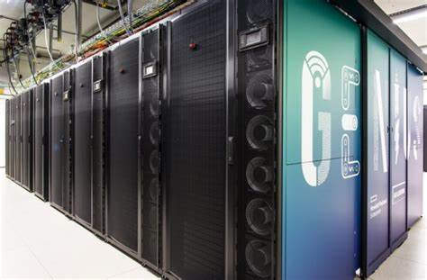
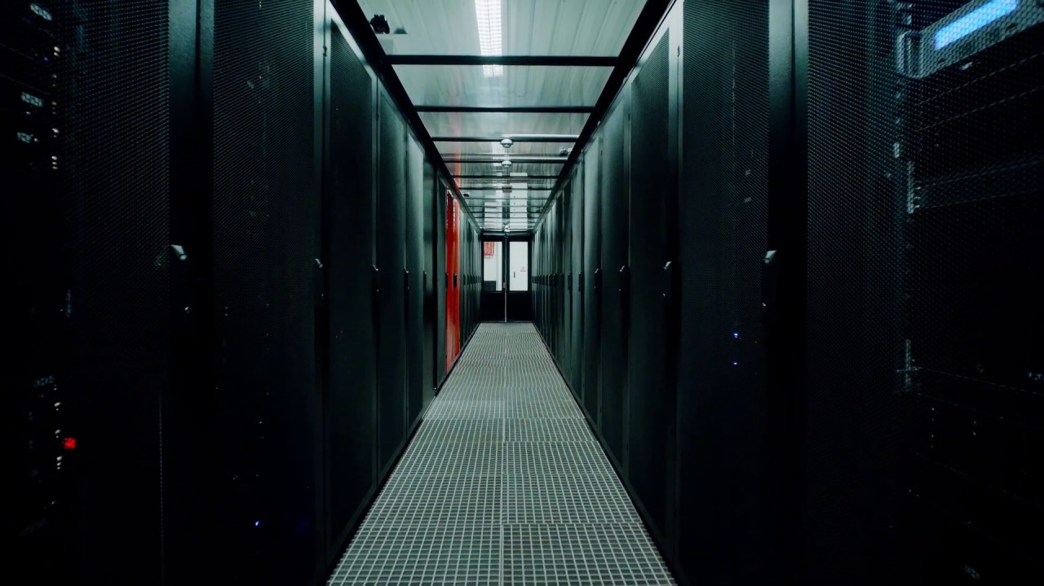

Compute nodes architecture
CPU partitions
Intel/AMD
From 28 up to 128 cores on a single node
From 196 up to 8TB total RAM per node
GPU partitions
NVIDIA/AMD
2/4 GPUs per node
Node local disks size
Regular – up to 2TB
SSD – up to 800GB

Slide 6
Tier-2 at KU Leuven
Node type | # cores | Installed mem | # nodes
Cascadelake | 36 | 192 GB | 144
Skylake large mem | 36 | 768 GB | 7
Skylake GPU | 36 | 192 GB | 20
Cascadelake GPU | 36 | 768 GB | 2
Genius
Node type | # cores | Installed mem | # nodes
Icelake | 72 | 256 GB | 172
Icelake large mem | 72 | 2 TB | 5
Icelake GPU | 72 | 512 GB | 4
Icelake Interactive | 64 | 512 GB | 4 + 1
Sapphire Rapids | 96 | 256 GB | 68
Icelake large mem | 72 | 8 TB | 1
AMD GPU | 64 | 768 GB | 4
Wice

Slide 7

Serial Application (1 process on 1 core)
Workflow
Batch
Interactive
Software
Modules
Containers
OnDemand
Single Process
One node
Multi-Core Appl. (N threads on N cores from 1 node)
Thread Group
Process Group
Distributed Appl. (many processes on
multiple cores/nodes)

Slide 8
Data

Slide 9
Storage infrastructure
Only you own your files (POSIX) Users can share folders via VSC groups
A VSC account has 3 default storages (free of charge)
HOME
DATA
SCRATCH
You can additionally request Staging storage
Different storage volumes have different:
size and performance
backup and maintenance policy
More info on ICTS Service Catalog
Currently at Leuven:
100+ BioInf projects
Staging 3PB (4.5PB total)
1PB necessary for Scratch operations
9
Notes:
All VSC users can use Tier-2 clusters from any site they desire.
If you still require more compute resources which does not fit into available Tier-2 limits, you can apply for Tier-1 compute time.
Even if Tier-1 level is insufficient, you can apply for Tier-0 level where Belgium is also part of a European consortium.

Slide 10






Data centralization
ManGO
BioInf 1.35PB
Tier-1 Data
27PB total
Double copy two data centers
Tier-1 Compute
Tier-2 Compute
Instruments
Laptops/desktops
Tier-1 Data
Active data
Inactive data
Regional / domain specific repositories
Institutional
repositories

Slide 11





Data flow
ACTIVE
PUBLISHED
LONG TERM
Data
collection
Data
storage
Metadata attribution
Data processing
Data
publishing
Metadata
publishing
Data
archiving
Data
preservation
Tier-1 Data
Coming-up
Notes:
Next session remove (RDR +) coming-up

Slide 12
Support and services
Basic support
Helpdesk (hpcinfo@kuleuven.be)
Monitoring and reporting
Application support
Installation and porting
Optimisation and debugging
Benchmarking
Workflows and best practices
Training
Documentation and tutorials
Scheduled trainings / workshops
On request workshops
One-to-one sessions
12
Notes:
All VSC users can use Tier-2 clusters from any site they desire.
If you still require more compute resources which does not fit into available Tier-2 limits, you can apply for Tier-1 compute time.
Even if Tier-1 level is insufficient, you can apply for Tier-0 level where Belgium is also part of a European consortium.

Slide 13
Questions
Helpdesk: hpcinfo@kuleuven.be
VSC web site: http://www.vscentrum.be
VSC documentation: https://docs.vscentrum.be
VSC agenda, training sessions, events: https://www.vscentrum.be/vsctraining
Systems status page: https://status.vscentrum.be
KU Leuven Service Catalogue:
https://icts.kuleuven.be/sc

